Slide 1

Change the flow of a program
Behram Khan

Slide 2
Lecture Overview
In this first lecture we will cover the fundamental theoretical concepts that form the backbone of programming.
This session focuses solely on theory along with practical examples, providing a solid foundation for understanding computers and programming
Involving examples and interactive session to develop problem solving

Slide 3
Learning Objectives
By the end of this lecture, students will be able to:
Know syntax of different statements
Know how data is displayed on screen
Know how data is taken from user as input
Know how if statements work and nested if’s
Know what are Boolean operators

Slide 4
Output in C
Output statements in programming are used to send data from the computer’s memory to an output device, like the screen (console), so users can see the results.
printf is a predefined output function in C used to display text and data on the console.
The console represents the computer display screen where results are shown.
Notes:
STR: Store a value to memory.
ADD: Add two values.
SUB: Subtract one value from another.
MOV: Move data from one location to another.

Slide 5
Printf
Instructs the computer to perform an action, namely to display on the screen the characters enclosed in the quotation marks.
Syntax of printf:
Basic Structure: printf("Data");

Slide 6
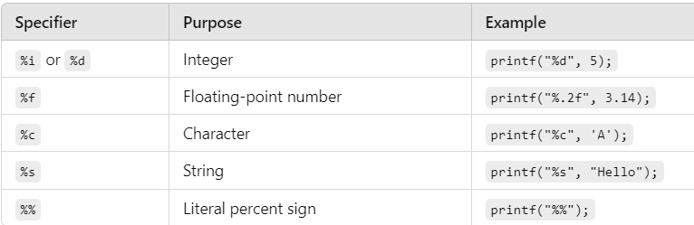
Format Specifiers
PrintFormatSpecifiers.c File
Notes:
STR: Store a value to memory.
ADD: Add two values.
SUB: Subtract one value from another.
MOV: Move data from one location to another.

Slide 7
Format Specifiers in output
Syntax :printf("Data + format specifiers", variable1, variable2, ...);
Example: printf("%i", variable);
Explanation of Components:
Data: Text or placeholders (format specifiers) for values to be displayed.
Variables: Actual values that replace the placeholders.
Notes:
STR: Store a value to memory.
ADD: Add two values.
SUB: Subtract one value from another.
MOV: Move data from one location to another.

Slide 8
Format Specifiers in output
#include<stdio.h>
int main()
{
int FirstNum = 1;
int SecondNum = 2;
float ThirdNum = 2.2;
printf("Hello World %i %i %f",FirstNum,SecondNum,ThirdNum);
return 0;
}
Notes:
STR: Store a value to memory.
ADD: Add two values.
SUB: Subtract one value from another.
MOV: Move data from one location to another.

Slide 9
Format Specifiers in output
#include<stdio.h>
int main()
{
int FirstNum = 1;
int SecondNum = 2;
float ThirdNum = 2.2;
printf("Hello World %i %i %f",FirstNum,SecondNum,ThirdNum);
return 0;
}
Notes:
STR: Store a value to memory.
ADD: Add two values.
SUB: Subtract one value from another.
MOV: Move data from one location to another.

Slide 10
Arithmetic Operations in printf
#include<stdio.h>
int main()
{
int FirstNum = 1;
int SecondNum = 2;
float ThirdNum = 2.2;
printf("Hello World %f", FirstNum + SecondNum + ThirdNum);
return 0;
}
Notes:
STR: Store a value to memory.
ADD: Add two values.
SUB: Subtract one value from another.
MOV: Move data from one location to another.

Slide 11
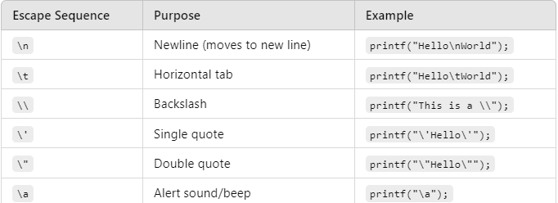
Escape Sequences
Escape sequences control the display of data on the output device. They are a combination of a backslash (\) and a code character.
EscapeSequence.c File
Notes:
STR: Store a value to memory.
ADD: Add two values.
SUB: Subtract one value from another.
MOV: Move data from one location to another.

Slide 12
Input Statements
Input statements are used to receive data from the user and assign it to variables.
When an input statement is executed, the program waits for the user to type a values. The entered value is then assigned to the specified variable, and the program continues its execution.
Inputtypes.c File
Notes:
STR: Store a value to memory.
ADD: Add two values.
SUB: Subtract one value from another.
MOV: Move data from one location to another.

Slide 13
Scanf
The scanf function is used to take input and store it in a variable.
To do this, scanf needs the address of the variable, not just its value, because it needs to know where in memory to store the input.
Syntax : scanf("format specifier(s)", &variable1, &variable2, ...);
Format Specifiers for Input:
%d: Integer
%f: Floating-point number
%c: Character
Notes:
STR: Store a value to memory.
ADD: Add two values.
SUB: Subtract one value from another.
MOV: Move data from one location to another.

Slide 14
Scanf
Why &variable?
•Memory Address: The & (address-of) operator provides the memory address of the variable.
•Storing Input: scanf takes that address and places the user input directly into that memory location, updating the variable with the new value.
Notes:
STR: Store a value to memory.
ADD: Add two values.
SUB: Subtract one value from another.
MOV: Move data from one location to another.

Slide 15
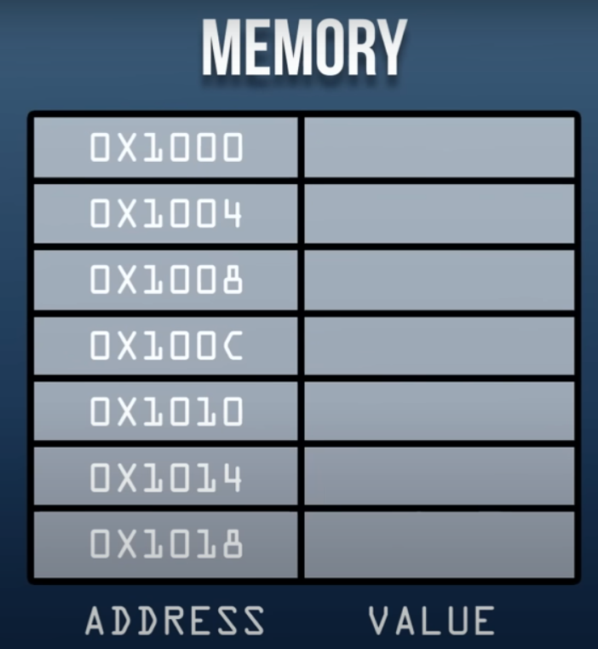





Scanf
Int a =5 ;
Printf (“%i”, a);
Notes:
STR: Store a value to memory.
ADD: Add two values.
SUB: Subtract one value from another.
MOV: Move data from one location to another.

Slide 16









Scanf
Int a =5 ;
Scanf(“ %i ” , &a);
Printf (“%i”, a);
Notes:
STR: Store a value to memory.
ADD: Add two values.
SUB: Subtract one value from another.
MOV: Move data from one location to another.

Slide 17










Scanf
Int a =5 ;
Scanf(“ %i ” , &a);
Printf (“%i”, a);
Notes:
STR: Store a value to memory.
ADD: Add two values.
SUB: Subtract one value from another.
MOV: Move data from one location to another.

Slide 18
Scanf
Can take multiple inputs at a time.
int main ()
{
int numberOne;
char numberOneFirstLetter;
printf("Enter a number and its first letter \n");
scanf("%i%c", &numberOne, &numberOneFirstLetter);
printf(" %i,%c",numberOne,numberOneFirstLetter);
}
//If added space between format specifiers, it will ask for empty input.
Notes:
STR: Store a value to memory.
ADD: Add two values.
SUB: Subtract one value from another.
MOV: Move data from one location to another.

Slide 19
Getch
Reads single character input from user but doesn’t wait for us to press enter key, as soon as we press a key, it displays the output.
Doesn’t show the pressed key on screen, Hide inputs like password, ATM pins…
Notes:
STR: Store a value to memory.
ADD: Add two values.
SUB: Subtract one value from another.
MOV: Move data from one location to another.

Slide 20

Getch
#include <conio.h> // Library where getch() is stored
#include <stdio.h> int main() {
char ch;
printf("Press any key to continue...");
ch = getch(); // waits for a key press, doesn't display it
printf("\nYou pressed: %c\n", ch);
return 0;
}
Notes:
STR: Store a value to memory.
ADD: Add two values.
SUB: Subtract one value from another.
MOV: Move data from one location to another.

Slide 21
Flow of Control

Slide 22





Flow of Control
Statements in a program execute one after the other in the order in which you write them. This is called sequential execution.
Various C statements enable you to specify that the next statement to execute may be other than the next one in sequence. This is called transfer of control.
Notes:
STR: Store a value to memory.
ADD: Add two values.
SUB: Subtract one value from another.
MOV: Move data from one location to another.

Slide 23
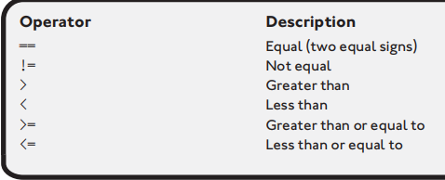
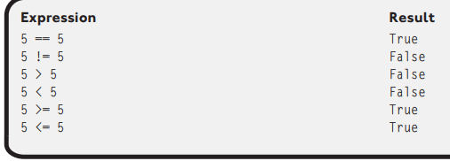
Comparison Operators
These are operators used to compare values and evaluate to either true or false.
Notes:
STR: Store a value to memory.
ADD: Add two values.
SUB: Subtract one value from another.
MOV: Move data from one location to another.

Slide 24
Flow of Control
An algorithm is a step-by-step process for solving a problem
To write an algorithm we use Pseudo Code and Flowchart
Notes:
STR: Store a value to memory.
ADD: Add two values.
SUB: Subtract one value from another.
MOV: Move data from one location to another.

Slide 25
Problem Statement 1
Turn the air conditioning on when the temperature is greater than or equal to 80 degrees or else turn it off.
Identify the Inputs, processing, outputs in the pseudocode.
Notes:
STR: Store a value to memory.
ADD: Add two values.
SUB: Subtract one value from another.
MOV: Move data from one location to another.

Slide 26
Problem Statement 1 PseudoCode
if temperature >= 80
Turn AC on
else
Turn AC off
end if
This is pseudocode not actual code, if u paste this in a C Program, it wont compile.
Notes:
STR: Store a value to memory.
ADD: Add two values.
SUB: Subtract one value from another.
MOV: Move data from one location to another.

Slide 27
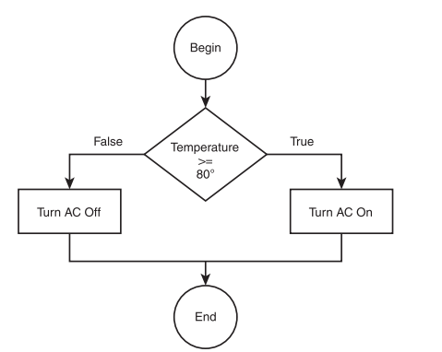
Problem Statement 1 Flowchart
Notes:
STR: Store a value to memory.
ADD: Add two values.
SUB: Subtract one value from another.
MOV: Move data from one location to another.

Slide 28
Problem Statement 2
Allow a customer to deposit or withdraw money from a bank account, and if a user elects to withdraw funds, ensure that sufficient money exist.
Identify the Inputs, processing, outputs in the pseudocode.
Notes:
STR: Store a value to memory.
ADD: Add two values.
SUB: Subtract one value from another.
MOV: Move data from one location to another.

Slide 29
Problem Statement 2 PseudoCode
if action == deposit
Deposit funds into account
else
if balance < withdraw amount
Insufficient funds for transaction
else
Withdraw monies
end if
end if
Notes:
STR: Store a value to memory.
ADD: Add two values.
SUB: Subtract one value from another.
MOV: Move data from one location to another.

Slide 30
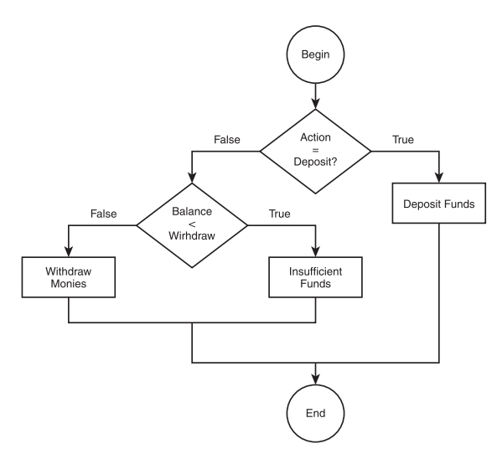
Problem Statement 2 Flowchart
Notes:
STR: Store a value to memory.
ADD: Add two values.
SUB: Subtract one value from another.
MOV: Move data from one location to another.

Slide 31
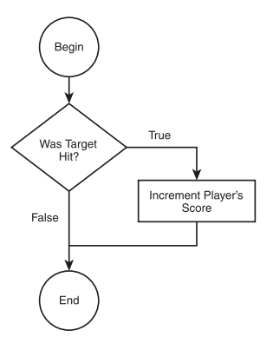
Problem Statement 3
if target hit == true
Increase player’s score
end if
Notes:
STR: Store a value to memory.
ADD: Add two values.
SUB: Subtract one value from another.
MOV: Move data from one location to another.

Slide 32
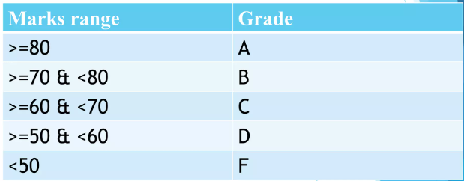
Problem Statement 4
Notes:
STR: Store a value to memory.
ADD: Add two values.
SUB: Subtract one value from another.
MOV: Move data from one location to another.

Slide 33

Problem Statement 4
Input marks
If marks >= 80 and marks <= 100
grade = "A"
End if
If marks >= 70 and marks <= 79
grade = "B"
End if
If marks >= 60 and marks <= 69
grade = "C"
End if
If marks >= 50 and marks <= 59 grade = "D“
End if
If marks < 50
grade = "F“
End if
Output grade
Notes:
STR: Store a value to memory.
ADD: Add two values.
SUB: Subtract one value from another.
MOV: Move data from one location to another.

Slide 34
If statement A Decision-Making Tool

Slide 35
If Statement
An if statement allows you to execute a block of code only if a certain condition is true.
It's like a decision-making process: if a specific condition is met, you take one action; otherwise, you take another.
Syntax :
if (condition)
{ Code to be executed if the condition is true }
• Condition: This is an expression that evaluates to either true or false.
• Code Block: This is a block of code that will be executed if the condition is true.
Notes:
STR: Store a value to memory.
ADD: Add two values.
SUB: Subtract one value from another.
MOV: Move data from one location to another.

Slide 36
If Statement
if (Temperature >= 80) //Turn AC on
else //Turn AC off
The first statement is the condition, which checks for a true or false result in the expression (Temperature >= 80). The expression must be enclosed in parentheses. If the expression’s result is true, the Turn AC on code is executed; if the expression’s result is false, the else part of the condition is executed. Also note that there is no end if statement in C.
Notes:
STR: Store a value to memory.
ADD: Add two values.
SUB: Subtract one value from another.
MOV: Move data from one location to another.

Slide 37
Temperature Checking
if (Temperature >= 80) {
//Turn AC on
printf("\nThe AC is on\n");
}
If(Temperature <= 20)
//Turn AC off
printf("\nThe AC is off\n");
}
AcOnOff.c
Notes:
STR: Store a value to memory.
ADD: Add two values.
SUB: Subtract one value from another.
MOV: Move data from one location to another.

Slide 38
Even Odd
if ( number % 2 == 0 ) {
printf("\n Number is even \n");
}
EvenOdd.c
Notes:
STR: Store a value to memory.
ADD: Add two values.
SUB: Subtract one value from another.
MOV: Move data from one location to another.

Slide 39
If else Statement
An if-else statement lets you execute one block of code if a specific condition is true, and a different block of code if that condition is false. It allows for two possible outcomes: one action when the condition is met and another when it isn’t.
if (condition) { // Code to be executed if the condition is true}
else { // Code to be executed if the condition is false}
Condition: This is an expression that evaluates to either true or false.
If Block: This block of code executes if the condition is true.
Else Block: This block of code executes if the condition is false.
Notes:
STR: Store a value to memory.
ADD: Add two values.
SUB: Subtract one value from another.
MOV: Move data from one location to another.

Slide 40
If else Statement
if (Temperature >= 80) {
//Turn AC on
printf("\nThe AC is on\n");
}
else {
//Turn AC off
printf("\nThe AC is off\n");
}
AcOnOff_If_Else.c
Notes:
STR: Store a value to memory.
ADD: Add two values.
SUB: Subtract one value from another.
MOV: Move data from one location to another.

Slide 41
If else Statement
START
SET number to 5
IF number is greater than 0 THEN
PRINT "The number is positive."
ELSE
PRINT "The number is not positive.“
End If
END
positiveNumber.c
Notes:
STR: Store a value to memory.
ADD: Add two values.
SUB: Subtract one value from another.
MOV: Move data from one location to another.

Slide 42
Nested If
A nested if statement is a decision-making structure that allows you to check multiple conditions within another if or else block.
In simple terms, it means having an if statement inside another if statement. This helps in making decisions based on more than one condition.
Notes:
STR: Store a value to memory.
ADD: Add two values.
SUB: Subtract one value from another.
MOV: Move data from one location to another.

Slide 43


Checking if a number is positive, and if positive, whether it’s even or odd.
START
SET number to 8
IF number is greater than 0 THEN
IF number MOD 2 is equal to 0 THEN
PRINT "The number is positive and even."
END IF
IF number MOD 2 is not equal to 0 THEN
PRINT "The number is positive and odd."
END IF
END IF
END
Notes:
STR: Store a value to memory.
ADD: Add two values.
SUB: Subtract one value from another.
MOV: Move data from one location to another.

Slide 44
Boolean Algebra

Slide 45
Boolean Algebra
Boolean algebra is named after George Boole, a mathematician in the nineteenth century. Boole developed his own branch of logic containing the values true and false and the operators and, or, and not to manipulate the values.
Boolean operators are used to combine or negate conditions in programming.
Three main Boolean operators are:
AND
OR
NOT
Notes:
STR: Store a value to memory.
ADD: Add two values.
SUB: Subtract one value from another.
MOV: Move data from one location to another.

Slide 46
The AND Operator
The AND operator builds a compound conditions.
Both conditions on either side must be true for the entire condition to be true
Example 1:
3 == 3 AND 4 == 4
Result: True (Both conditions are true)
Example 2:
3 == 4 AND 4 == 4
Result: False (Only one condition is true)
Notes:
STR: Store a value to memory.
ADD: Add two values.
SUB: Subtract one value from another.
MOV: Move data from one location to another.

Slide 47
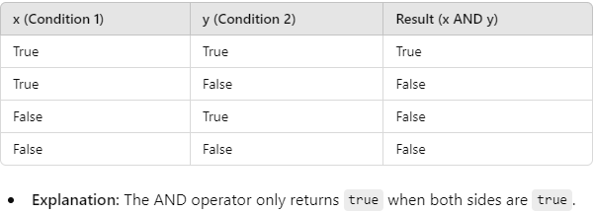
The AND Operator
Notes:
STR: Store a value to memory.
ADD: Add two values.
SUB: Subtract one value from another.
MOV: Move data from one location to another.

Slide 48
The OR Operator
The OR operator builds a compound conditions.
Only one condition needs to be true for the entire expression to be true.
Example 1:
4 == 3 AND 4 == 4
Result: True (One conditions is true)
Example 2:
3 == 4 AND 4 == 5
Result: False (Both conditions is false)
Notes:
STR: Store a value to memory.
ADD: Add two values.
SUB: Subtract one value from another.
MOV: Move data from one location to another.

Slide 49
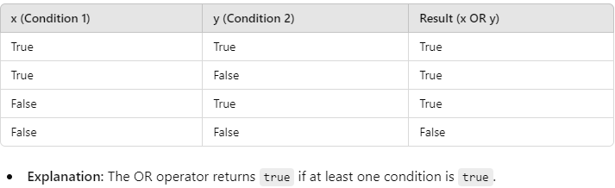
The OR Operator
Notes:
STR: Store a value to memory.
ADD: Add two values.
SUB: Subtract one value from another.
MOV: Move data from one location to another.

Slide 50
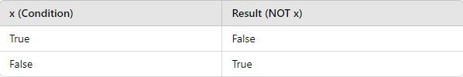
The NOT Operator
The NOT operator negates a condition.
It inverts the value of a condition (if it’s true, it becomes false; if it’s false, it becomes true).
Example 1:
NOT( 4 == 4 )
Result: False (4 == 4 is true, but NOT negates it)
Notes:
STR: Store a value to memory.
ADD: Add two values.
SUB: Subtract one value from another.
MOV: Move data from one location to another.

Slide 51
The NOT Operator
Notes:
STR: Store a value to memory.
ADD: Add two values.
SUB: Subtract one value from another.
MOV: Move data from one location to another.

Slide 52
Combining Operators
AND, OR, and NOT operators can be combined to create more complex conditions.
The order of operations is from Left to right :
NOT
AND
OR
Use parentheses () to control the order in which conditions are evaluated.
Notes:
STR: Store a value to memory.
ADD: Add two values.
SUB: Subtract one value from another.
MOV: Move data from one location to another.

Slide 53
Combining Operators
Example:
NOT(4 == 4) AND (5 == 5 OR 3 == 3)
First, evaluate the conditions inside the parentheses.
Then, apply the NOT operator.
Finally, apply the AND operator.
Notes:
STR: Store a value to memory.
ADD: Add two values.
SUB: Subtract one value from another.
MOV: Move data from one location to another.

Slide 54
Combining Operators
Try to solve the following Boolean algebra problems, given
x = 5, y = 3, and z = 4
1. x > 3 and z == 4 → True
2. y >= 3 or z > 4 → True
3. NOT(x == 4 or y < z) → false
4. (z == 5 or x > 3) and (y == z or x < 10) → true
Notes:
STR: Store a value to memory.
ADD: Add two values.
SUB: Subtract one value from another.
MOV: Move data from one location to another.

Slide 55
Boolean in C Programming

Slide 56
AND Operator (&&)
The AND (&&) operator checks if both conditions on either side are true.
Syntax: condition1 && condition2
Result: The entire expression is true only if both conditions are true.
Example 1:
if ( 3 > 1 && 5 < 10 )
Result: True because both 3 > 1 and 5 < 10 are true.
Example 2:
if ( 3 > 5 && 5 < 5 )
Result: False because 3 > 5 is false, so the entire condition fails.
Notes:
STR: Store a value to memory.
ADD: Add two values.
SUB: Subtract one value from another.
MOV: Move data from one location to another.

Slide 57
OR Operator (||)
The OR (||) operator checks if at least one condition is true.
Syntax: condition1 || condition2
Result: The entire expression is true if either condition is true.
Example 1:
if ( 3 > 5 || 5 <= 5 )
Result: True because 5 <= 5 is true (even though 3 > 5 is false).
Example 2:
if ( 3 > 5 || 6 < 5 )
Result: False because both conditions 3 > 5 and 6 < 5 are false.
Notes:
STR: Store a value to memory.
ADD: Add two values.
SUB: Subtract one value from another.
MOV: Move data from one location to another.

Slide 58
NOT Operator (!)
The NOT (!) operator is used to invert a condition. It returns true if the condition is false, and false if the condition is true.
Syntax: !condition
Result: Reverses the truth value of the condition.
Example 1:
if ( !( 3 > 5 ) )
Result: True because 3 > 5 is false, and the NOT operator inverts it to true.
Example 2:
if ( !( 5 < 5 ) )
Result: True because 5 < 5 is false, and the NOT operator inverts it to true.
Notes:
STR: Store a value to memory.
ADD: Add two values.
SUB: Subtract one value from another.
MOV: Move data from one location to another.

Slide 59
Combining AND (&&), OR (||), and NOT (!) Operators
if ( !( 3 > 5 && 4 == 4 ) || 7 == 7 )
printf("Condition is true\n");
First, the && operator evaluates the left condition.
Then, the NOT operator negates the result.
Finally, the || operator checks if the final result is true or false.
Notes:
STR: Store a value to memory.
ADD: Add two values.
SUB: Subtract one value from another.
MOV: Move data from one location to another.

Slide 60
Input Validation
Checking for a range of values is a common programming practice for input validation. You
can use compound conditions and relational operators to check for value ranges, as shown
in the following program:
InputValidation.c
Notes:
STR: Store a value to memory.
ADD: Add two values.
SUB: Subtract one value from another.
MOV: Move data from one location to another.

Slide 61
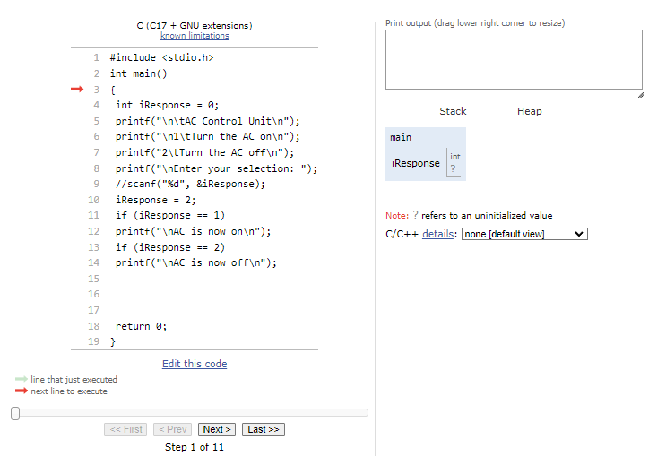
Step by step execution of If statements
Notes:
STR: Store a value to memory.
ADD: Add two values.
SUB: Subtract one value from another.
MOV: Move data from one location to another.

Slide 62
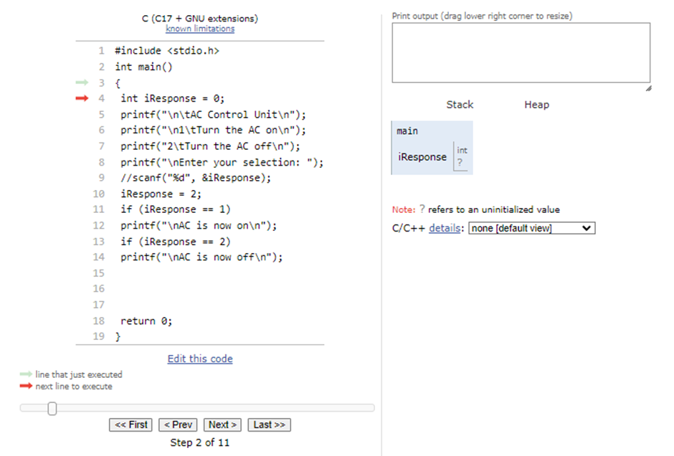
Step by step execution of If statements
Notes:
STR: Store a value to memory.
ADD: Add two values.
SUB: Subtract one value from another.
MOV: Move data from one location to another.

Slide 63
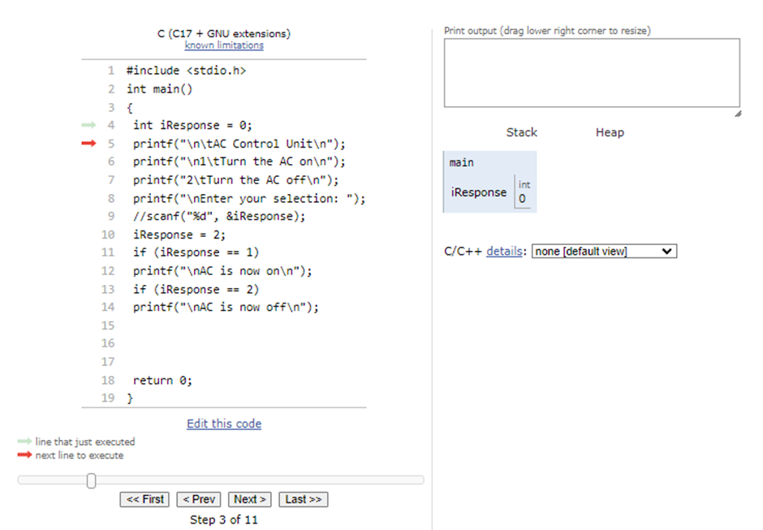
Step by step execution of If statements
Notes:
STR: Store a value to memory.
ADD: Add two values.
SUB: Subtract one value from another.
MOV: Move data from one location to another.

Slide 64
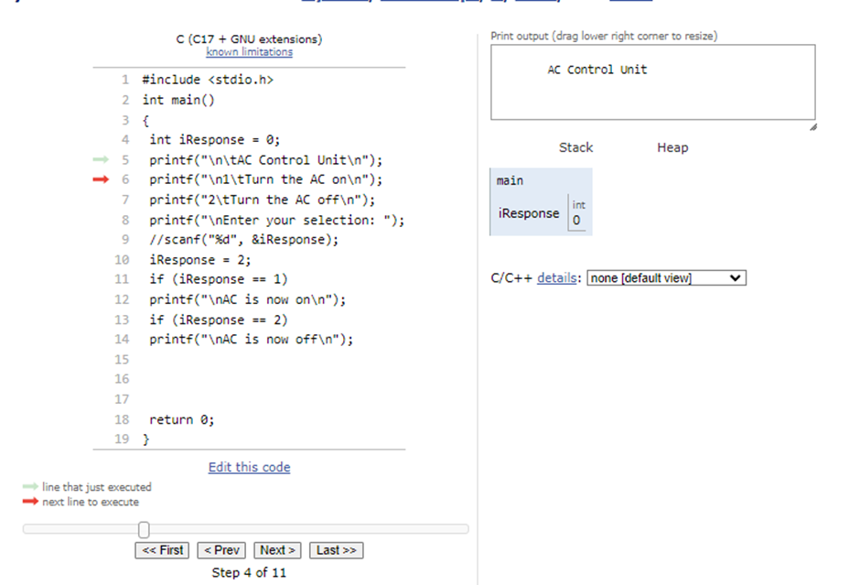
Step by step execution of If statements
Notes:
STR: Store a value to memory.
ADD: Add two values.
SUB: Subtract one value from another.
MOV: Move data from one location to another.

Slide 65
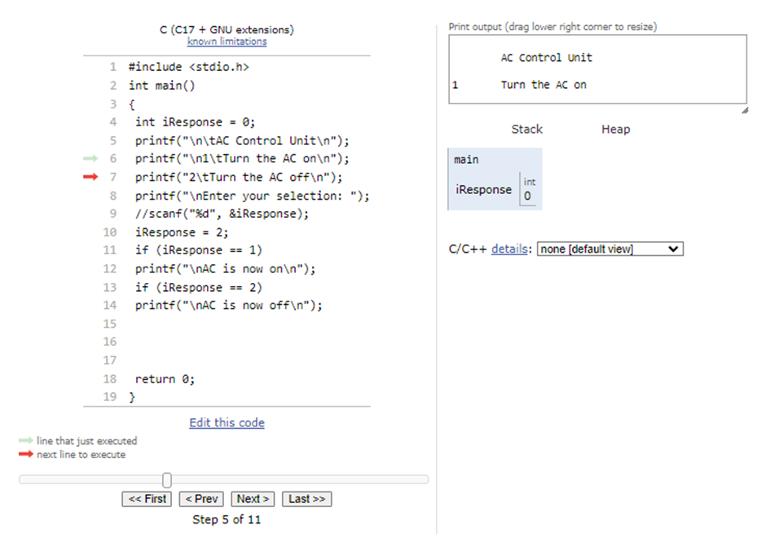
Step by step execution of If statements
Notes:
STR: Store a value to memory.
ADD: Add two values.
SUB: Subtract one value from another.
MOV: Move data from one location to another.

Slide 66
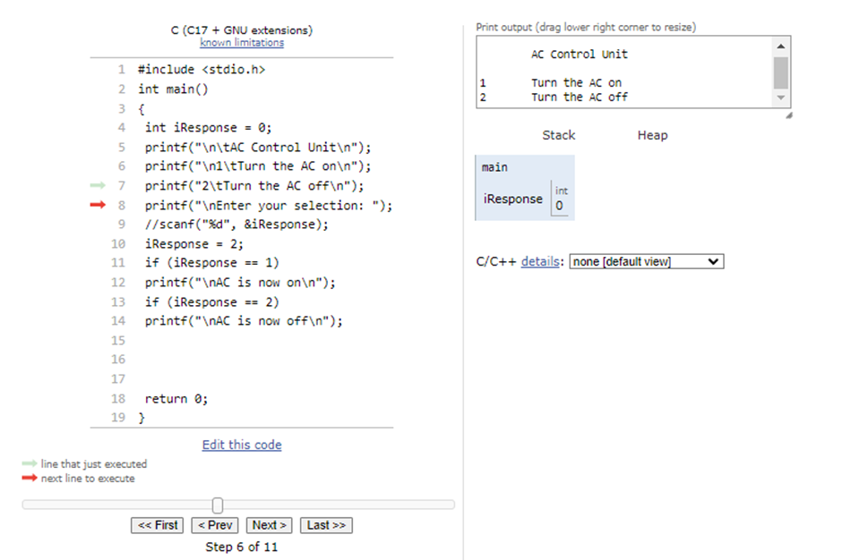
Step by step execution of If statements
Notes:
STR: Store a value to memory.
ADD: Add two values.
SUB: Subtract one value from another.
MOV: Move data from one location to another.

Slide 67
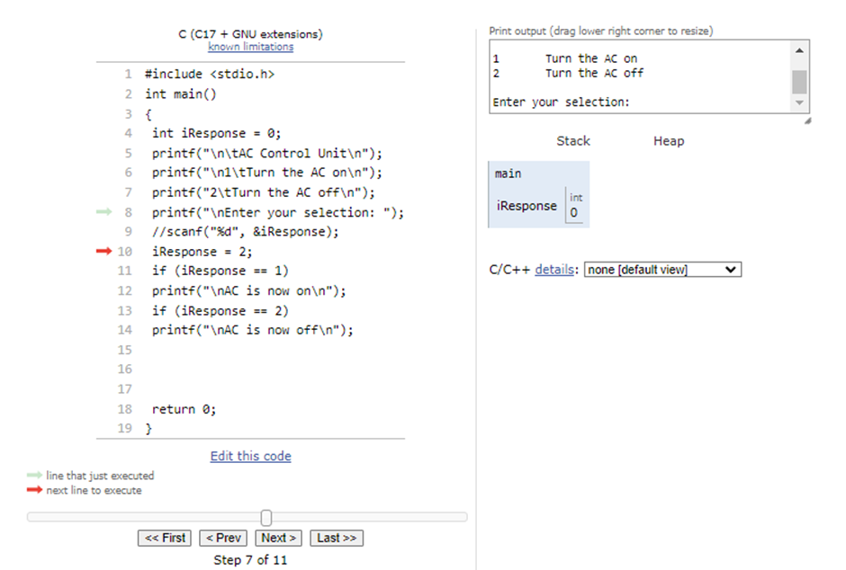
Step by step execution of If statements
Notes:
STR: Store a value to memory.
ADD: Add two values.
SUB: Subtract one value from another.
MOV: Move data from one location to another.

Slide 68
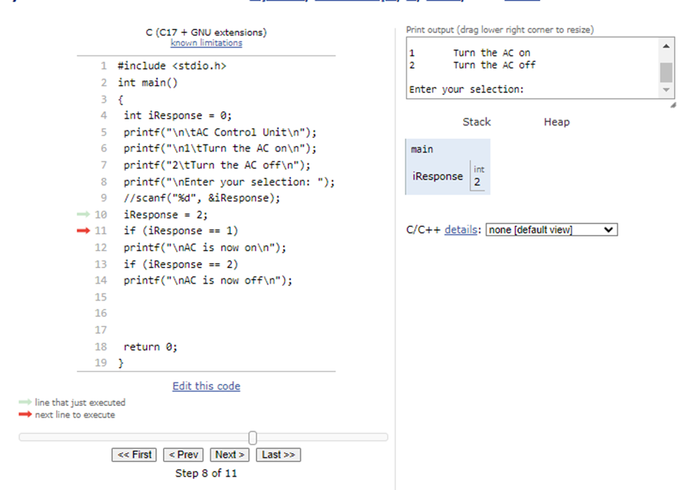
Step by step execution of If statements
Notes:
STR: Store a value to memory.
ADD: Add two values.
SUB: Subtract one value from another.
MOV: Move data from one location to another.

Slide 69
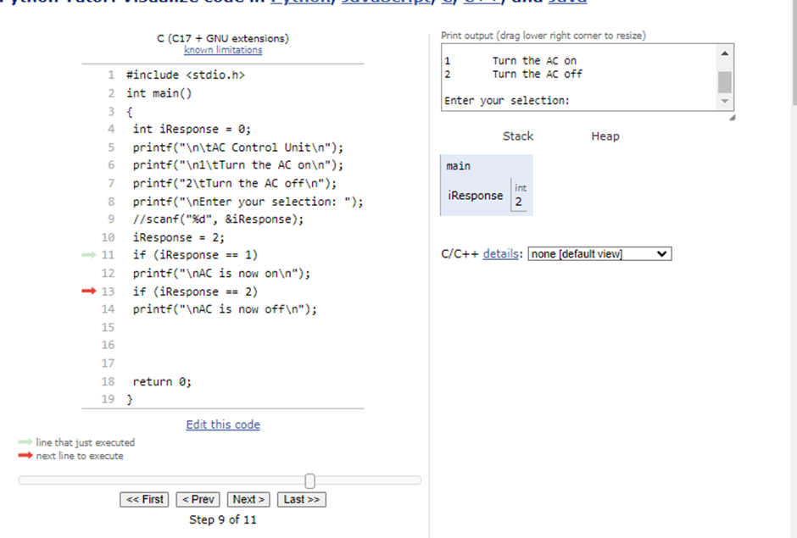
Step by step execution of If statements
Notes:
STR: Store a value to memory.
ADD: Add two values.
SUB: Subtract one value from another.
MOV: Move data from one location to another.

Slide 70
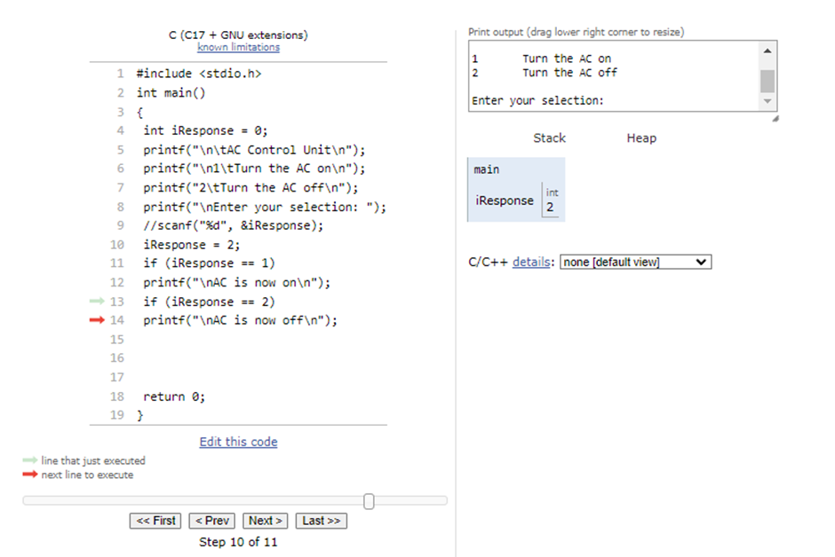
Step by step execution of If statements
Notes:
STR: Store a value to memory.
ADD: Add two values.
SUB: Subtract one value from another.
MOV: Move data from one location to another.

Slide 71
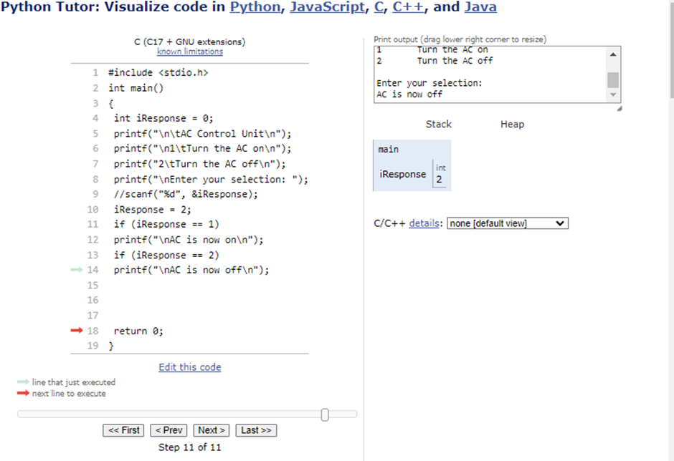
Step by step execution of If statements
Notes:
STR: Store a value to memory.
ADD: Add two values.
SUB: Subtract one value from another.
MOV: Move data from one location to another.

